Slide 1
2024 Post-Event Recap

Slide 2
High Level Event Recap/
Overview
Christin DeLuzio

Slide 3
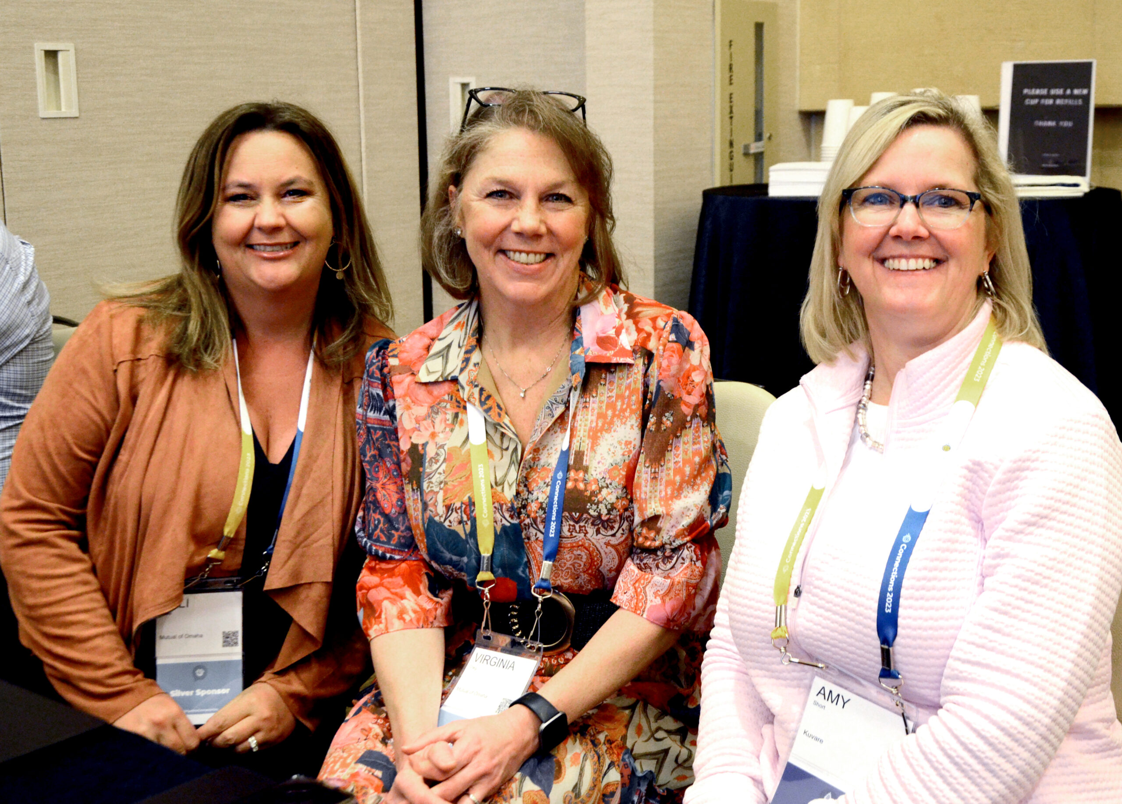
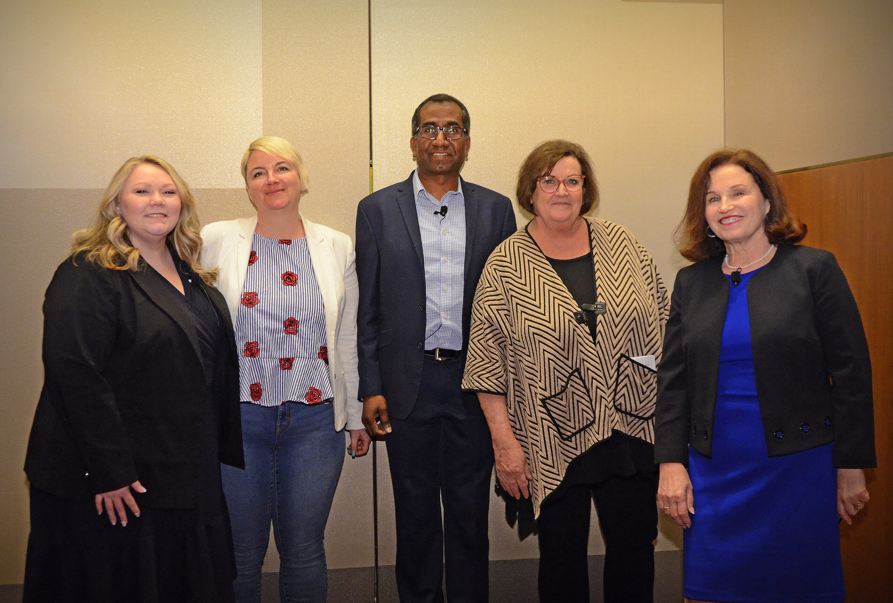
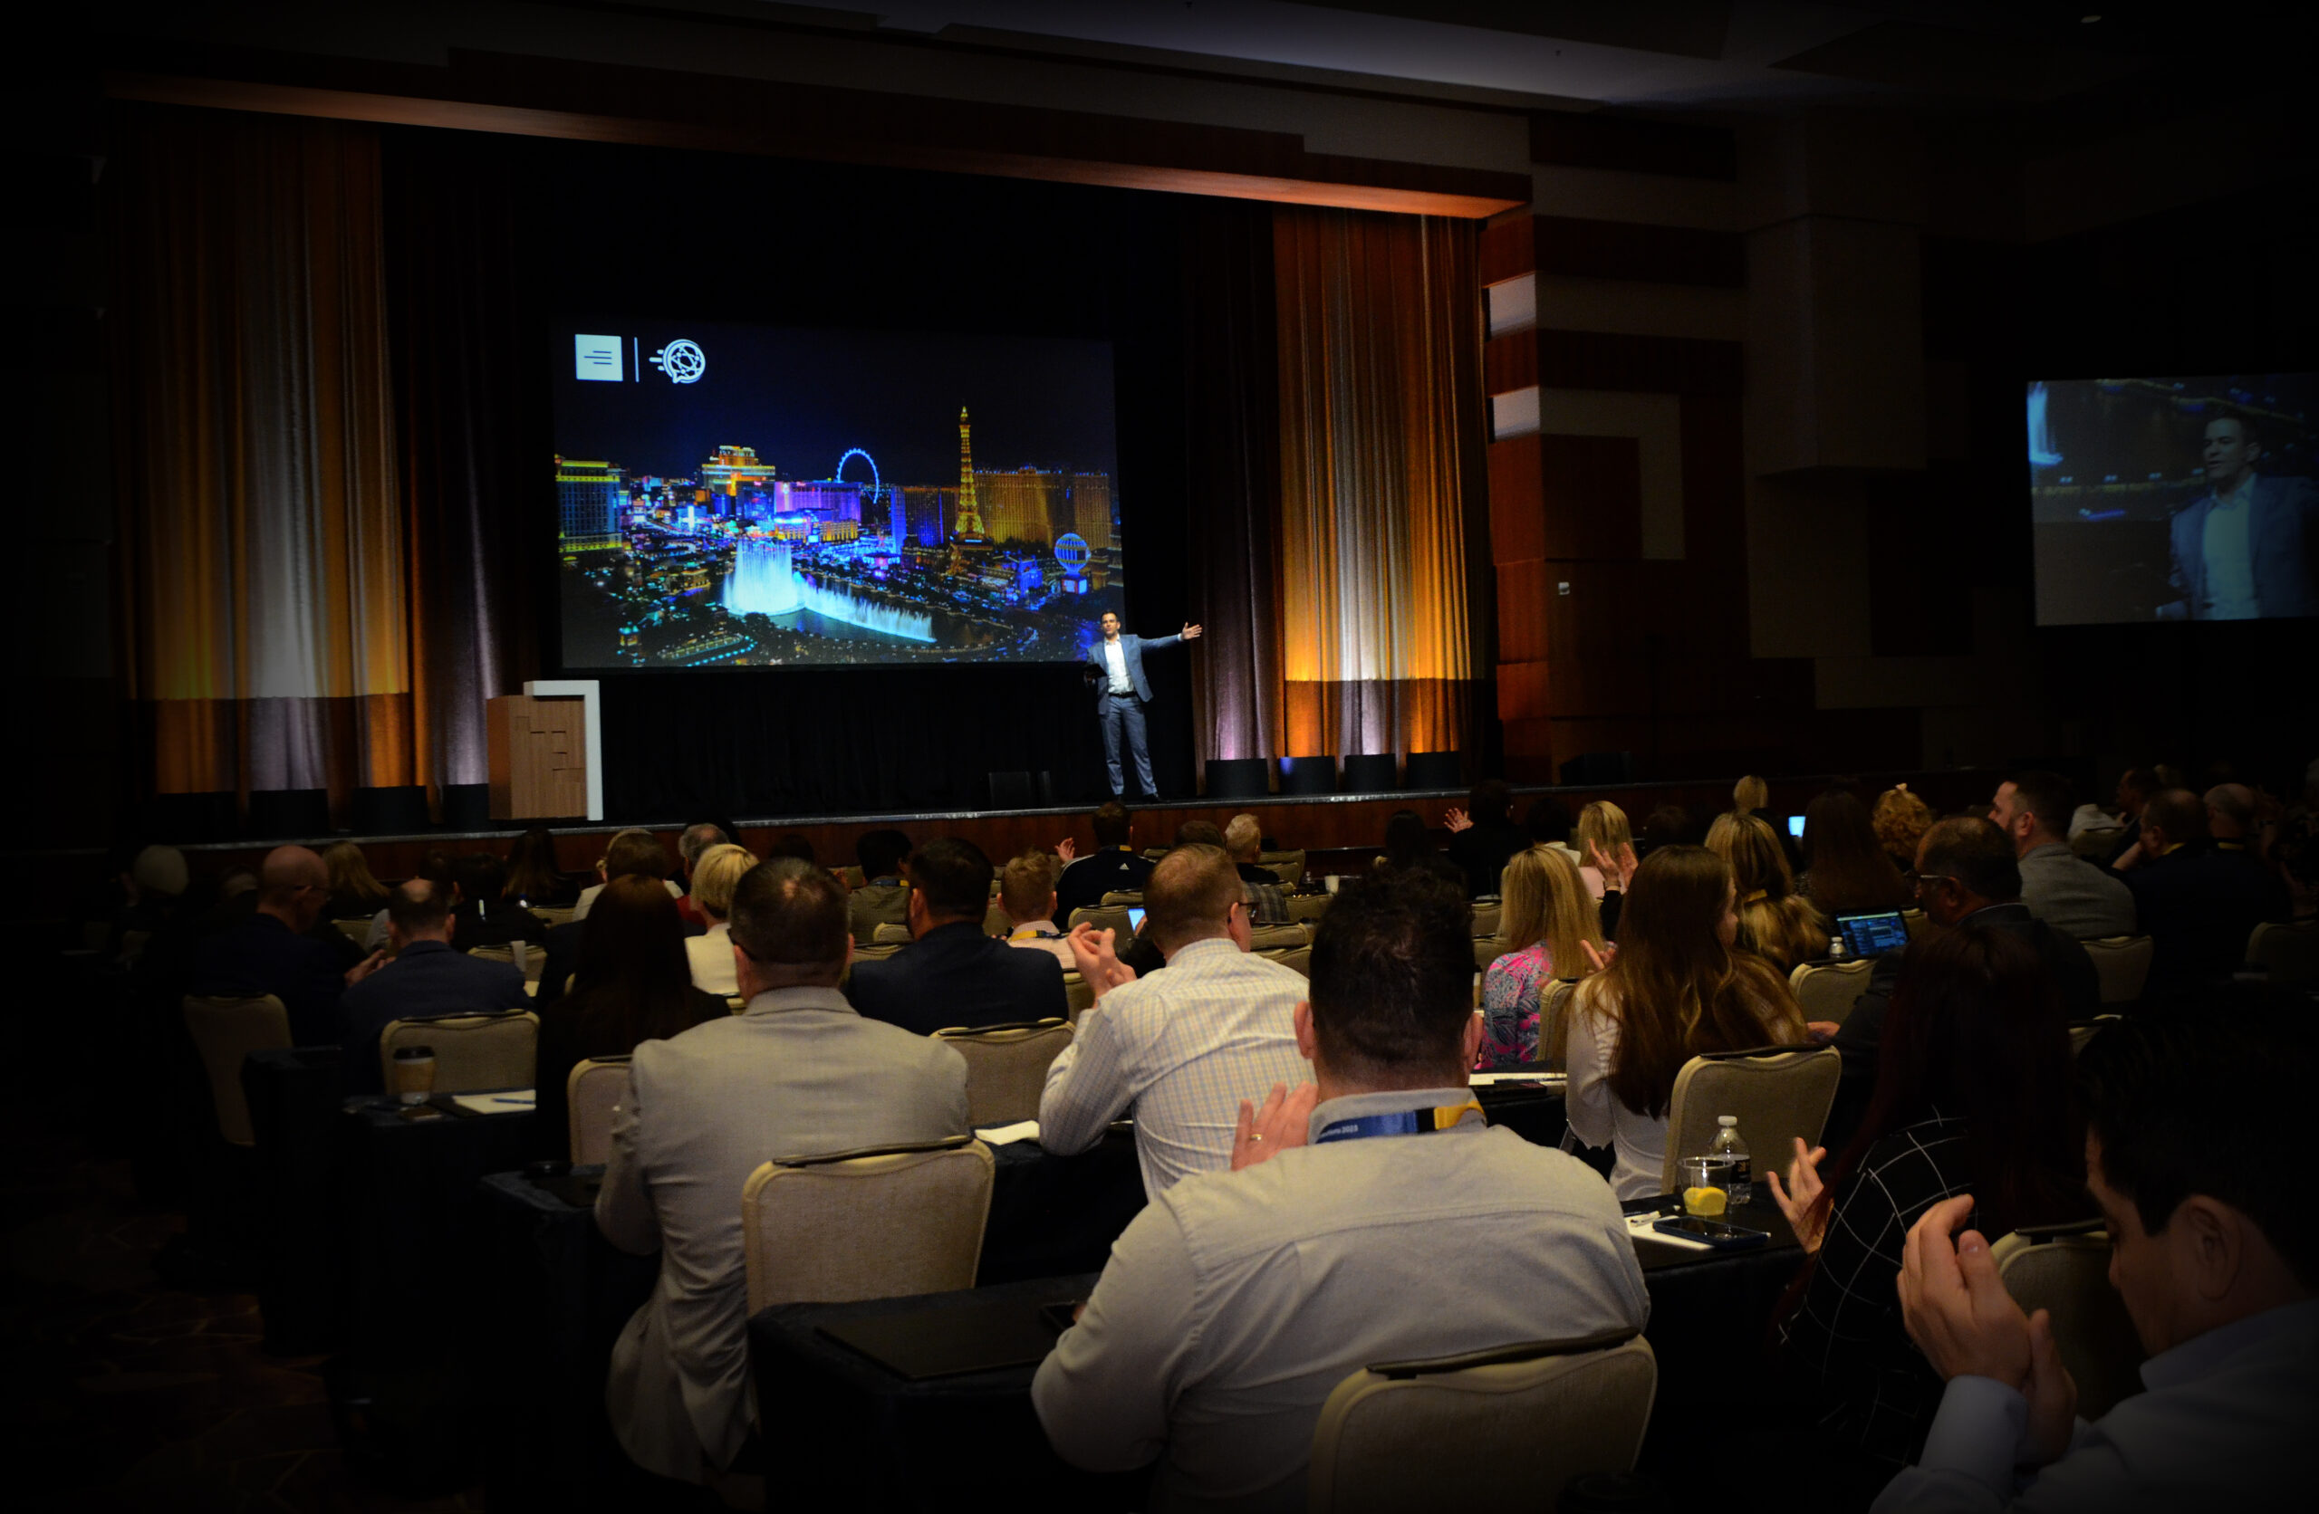
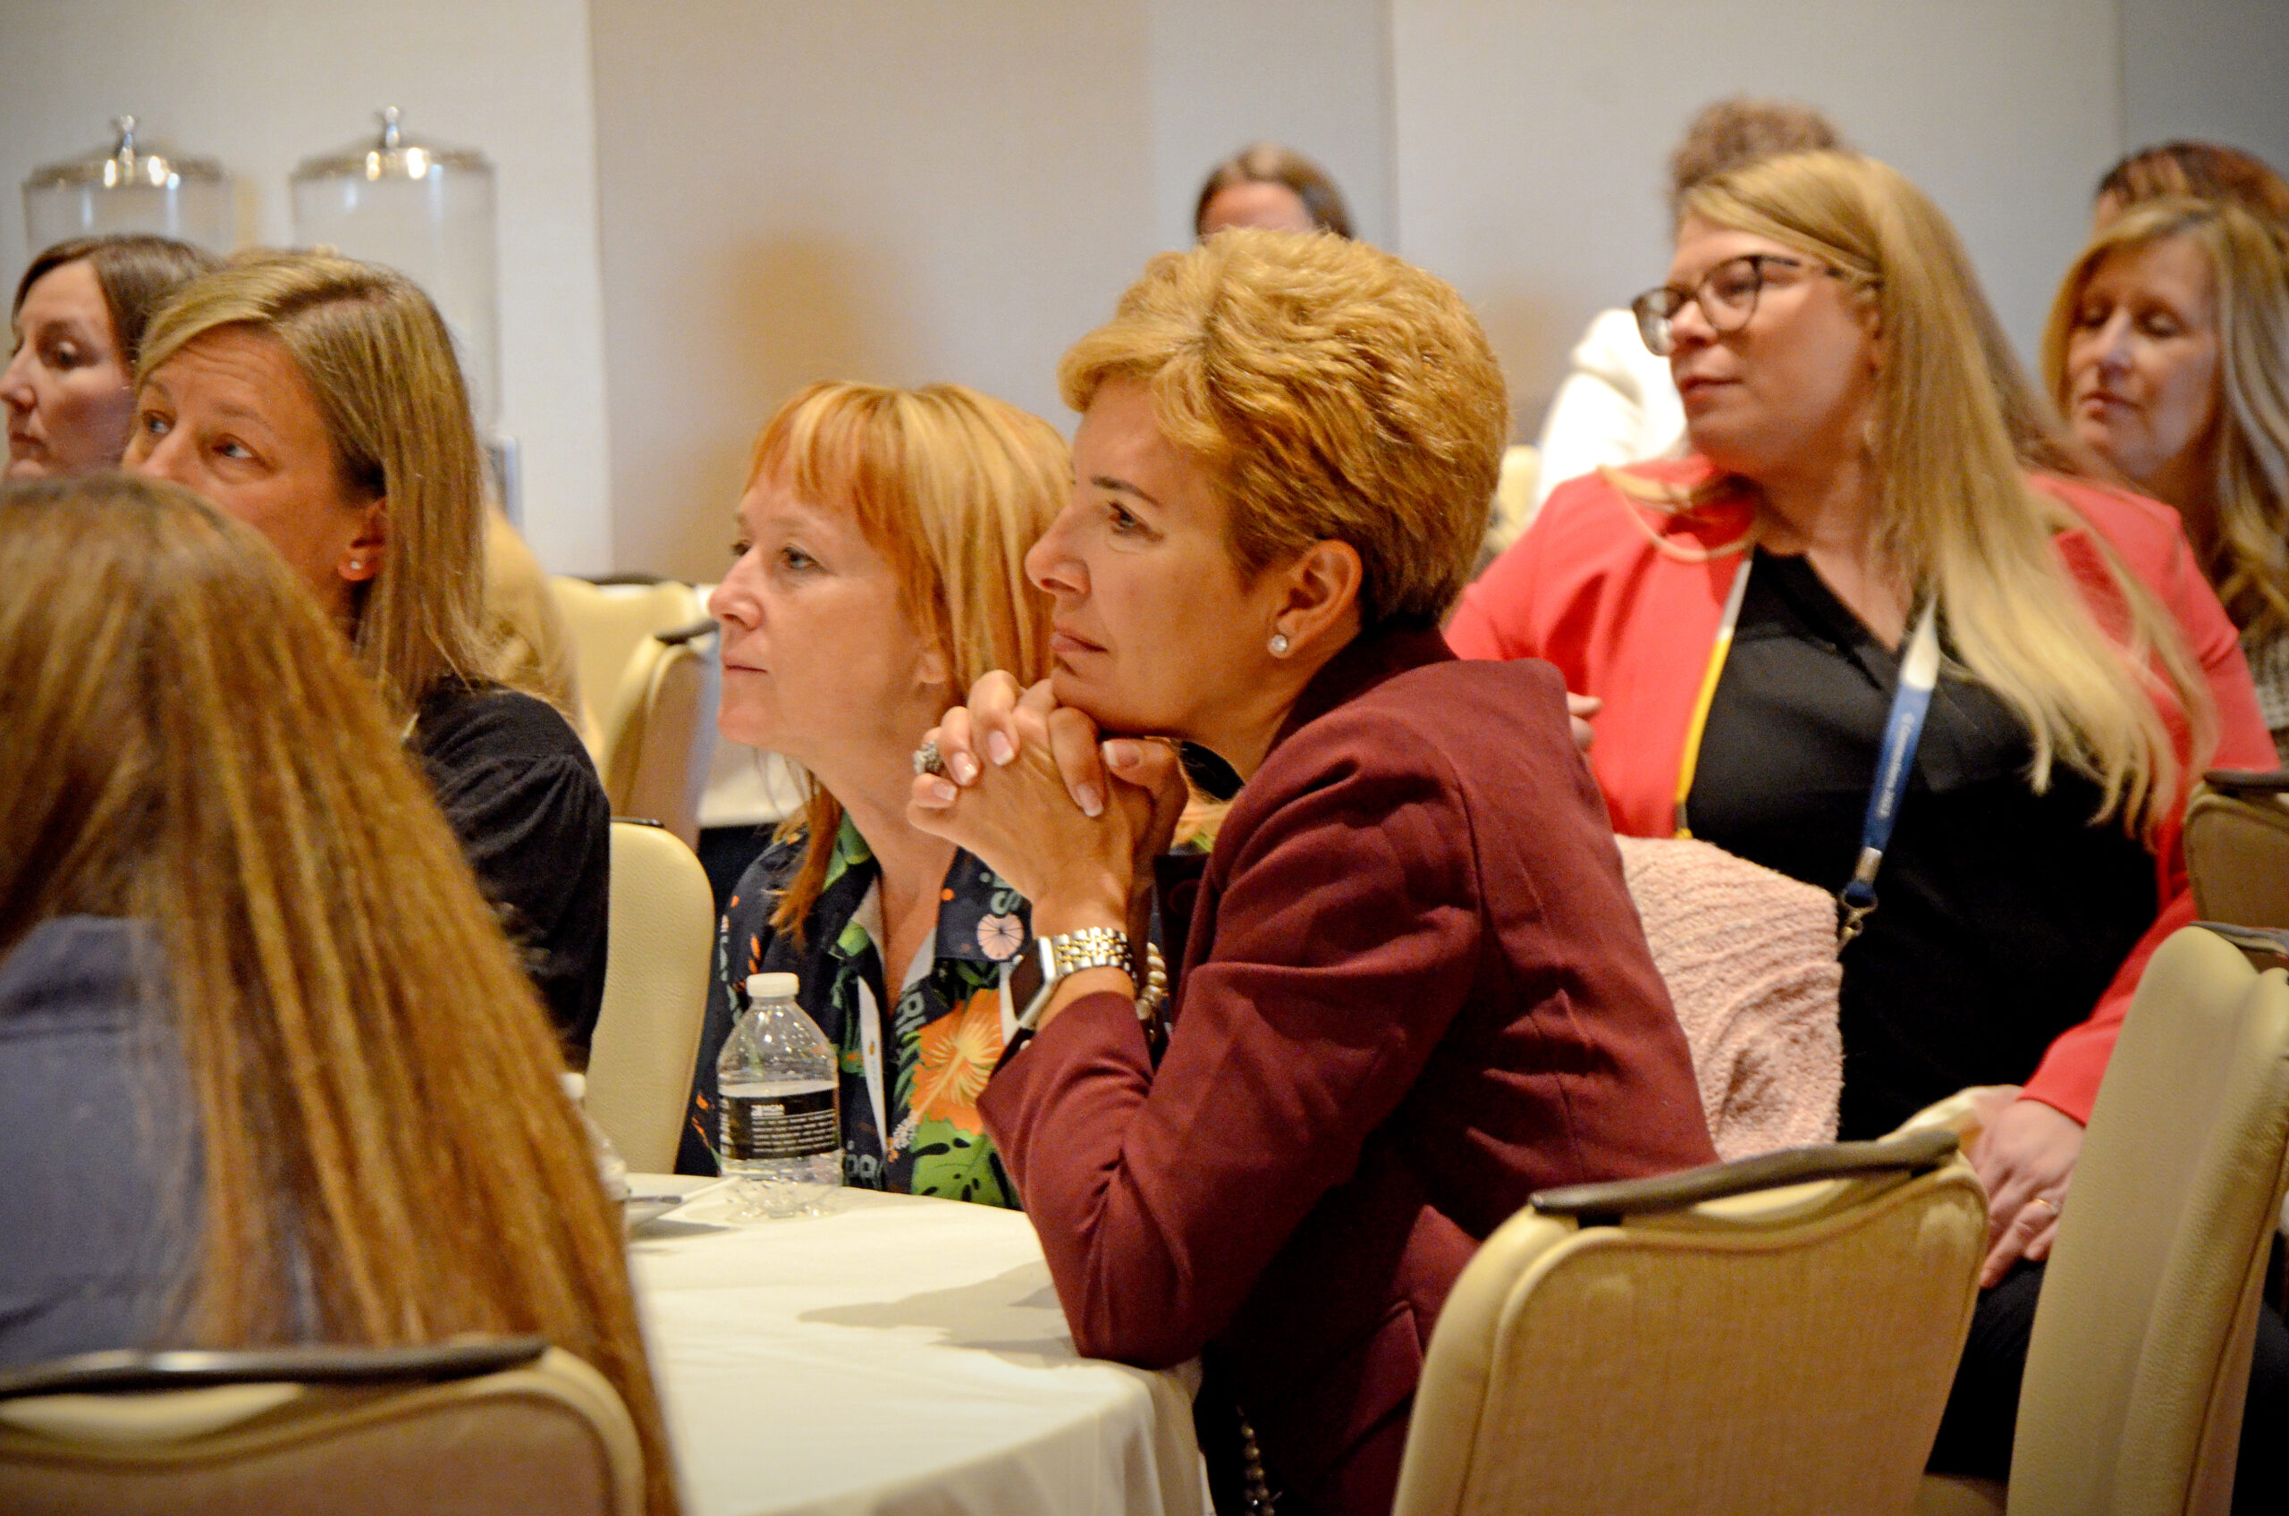
Conference Themes | Internal Use
Partnering with our clients to solve their most complex business challenges through our network of digital, market-leading, secure, and innovative solutions for the Life Insurance, Financial Services, and Wealth Management industries.
Continued investment in our end-to-end technology to empower digitization and reduce the overall use of paper, showcasing our dedication to social and environmental activities.
29 years of experience, strong financial backing, and a dedicated focus on our deep client relationships, providing them lifetime support in their digital journey to protect more families.
1
2
3
Notes:
Partnerships, digital, innovation.The purpose of these themes was to have a similar message woven throughout all sessions

Slide 4
Final Registration Numbers
2024 Final Status*: 308 Attendees
Type | # of Attendees | # of Unique Companies
BGA/IMO | 98 | 59 (20% increase)
Carrier | 100 | 47 (24% increase)
Financial Services | 46 | 24 (9% increase)
Type | # of Attendees | # of Unique
Sponsor/Partner | 54 | 24
Guest | 10 | 7
Notes:
The most notable thing to point out here is that we received 21 more additional unique companies in attendance then 2023
With an increase in attendance across Carriers, FIs and BGAs SO were really pleased with where we ended up with registration considering it was a completely new event

Slide 5
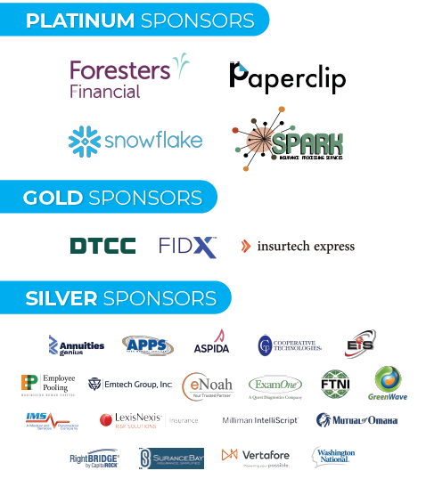
Sponsorship Update
27 Sponsors
Sponsor Sales:
$173,850
Notes:
Lots of events happening around the same time, so we were competing for sponsorship dollars. As a result, we feel like we received sponsors who are the most serious about our event and can offer the most value.

Slide 6
2024 Educational Lineup @ A Glance
46
35+
79
40
Breakout Sessions Carrier | BGA | Wealth
Hours of Educational Content
Total Speakers
3rd Party Speakers from 36 Companies
Notes:
A wide array of breakouts and session presenters we’re showcased
-app needs to be more intuitive, people could enroll in sessions if the session was full in the app
-what you enrolled in is what your particiate in, we want to mandtate it

Slide 7
2024 Key Event Changes
Early-Bird Pricing & New Sponsorship Pricing
New Dates, Location, and Venue
All New Vendors and Relationships for Event Team
Wealth Breakout Sessions & AFFIRM Roundtable
Enforced “No Discount” Policy
Re-Launched Customer Award Program
Notes:
Completely new event

Slide 8
Post-Event Survey Results:
Attendee
Jared Bruley

Slide 9
Response Overview: Attendee
99 Survey Completions
Carrier: 43 BGA/IMO: 35 Financial Services/Wealth: 21 43% of Responses 36% of Responses 21% of Responses
40% of Attendees Participated in Survey (+9% from 2023 & +23% from 2022)

Slide 10
Attendee Executive Summary | General Themes
Overall, attendee feedback for Connections 2024 came back favorable with survey scores improving in 13 of the 15 key areas of the event when compared to 2023
97% of respondents stated they were extremely satisfied or satisfied with the event
85% of respondents said they were ‘extremely pleased’ or ‘very pleased’ with the Omni (4.36 overall rating on venue out of 5-point scale)
Positive response regarding overall breakout session content with a thirst for additional wealth/annuity material and longer, more advanced breakout sessions
Networking, collaboration, and content were key to event success
Hunger for deeper-dive/overview into full suite of iPipeline products

Slide 11
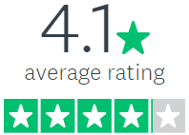
Attendee Survey Results At-A-Glance
97%
96%
(+9% from 2023)
(-4% from 2023)
(3.9 Average Rating in 2023)
Said they were Extremely Satisfied or Satisfied with Connections
Stated Connections was Extremely Organized/Very Organized
85%
95%
91%
(+3% from 2023)
(+14% from 2023)
(+6% from 2023)
Said they got all the information they were expecting to get
Liked the Connections Mobile App
Said they are Extremely Likely/Very Likely to attend another iPipeline event

Slide 12
Please rate your overall satisfaction with each of the following on a scale from 1 to 5 (with 1 being the lowest and 5 being the highest):
Area of Event | Weighted Average (1 – 5)
On-Site Registration Process | 4.86
Women's Luncheon | 4.80
Helpfulness of iPipeline Staff | 4.77
Pre-Event Registration Process | 4.69
Breakout Session Duration | 4.65
Opening Reception at SeaWorld | 4.63
Pre-Event Communications | 4.60
Amount of Networking Time | 4.58
Connections Event Website | 4.58
Keynote Presentation | 4.53
Lunch in the Exhibit Hall | 4.52
Breakfast in the Exhibit Hall | 4.39
Content Presented During Breakouts | 4.22
Exhibitor Reception | 4.19
General Session Content | 4.16
2023 Scores
4.68 (+.18 / +3.85%)
N/A
4.72 (+.05 / +1.06%)
4.66 (+.03 / +.64%)
4.49 (+.16 / +3.56%)
4.17 (+.46 / +11.03%)
4.55 (+.05 / +1.1%)
4.55 (+.03 / +.66%)
4.47 (+.11 / +2.46%)
4.42 (+.11 / +2.46%)
4.48 (+.04 / +.89%)
4.62 (-.23 / -4.98%)
4.15 (+.07 / +1.69%)
4.54 (-.35 / -7.71%)
4.07 (+0.9 / +2.21%)
2023 Spread:
High: 4.72 Low: 4.07

Slide 13
Attendee Open-Ended Responses

Slide 14
What Did You Like Most About Connections 2024?

Slide 15
Notes:
POSITIVE 1:
So many things were great. The iPipeline staff were all amazing and happy to help. The sessions were great. The emcee was Amazing! The Keynote speaker was Amazing! The ability to connect or re-connect with colleagues is always great.
POSITIVE 2:
This was the most beneficial conference I've been to. Bonus is the food was amazing and the resort is gorgeous!
POSITIVE 3:
The SeaWorld Event was so much fun and overall the content was engaging, informative and relevant.
POSITIVE 4:
This year was different than last year because there was more of a presence on the Financial Services side. Last year it seemed like I was at the wrong event.
POSITIVE 5:
This was my first Connections trip. I was very impressed with the entire conference, entertainment provided, and all the knowledge I was able to take back to our team from the sessions.

Slide 16
Did You Have a Favorite Breakout Session You Attended?

Slide 17
Notes:
All of the breakouts were informative. The session on AI, data strategies, and Snowflake were some of my highlights.
Not one favorite but the ones I enjoy the most are the collaborative ones where agencies can share best practices and insights into how they're using the different platforms.
The AI session was my favorite, a lot of great information presented at that session
Coming from a carrier perspective, I favored the ones that opened communication up between BGAs and the carriers. It was great getting to hear their needs so we can plan accordingly.
Breakout sessions that were more interactive between the audience and presenter(s) asking questions were more beneficial.

Slide 18
Did You Have a Least Favorite Breakout Session?

Slide 19
Notes:
Besides the general sessions (which focused heavily, almost entirely on Insurance) all other sessions offered something of value. I walked away from each with good notes and an expanded understanding of how other clients use other products of iPipeline.
No. The only issue was that there were simultaneous sessions that I wanted to attend and had to pick just one!!
I did not find session "What's next in underwriting" very interesting nor helpful. I found the name of the session misleading as it was all about artificial intelligence and I don't find this topic very interesting, but that's just me:)
Those that were more sales pitch focused.

Slide 20
What Would You Like to See Changed for Future Connections Events?

Slide 21
Notes:
I was very impressed with how organized everything was. I don't think I would change anything.
Maybe shorter general sessions and longer training sessions.
I think the meeting should start with hearing from iPipeline leadership with a keynote after to set the tone and energy for the meeting
More specifics around new features shown....are they available now or not? If not, when? How do we implement, etc. Have people in the session that can provide these specifics.
I'd love to have more advanced or in depth breakout sessions. Maybe there are and I didn't attend the right ones but the several I went to (BGA & Partner Ecosystem, User Group Enhancement Review, Administrator Training for Application Management, etc) were all very base level and most things I already knew.

Slide 22
Anything Else to Share About Your Experience?

Slide 23
Notes:
The iPipeline staff was amazing! Thanks for making me feel at home and providing such helpful information.
May is a busy month. I know some of our people were planning on coming, but couldn't due to other commitments. The breakout rooms were hard to find.
I'd like to see some more annuity focused discussions. I didn't feel like there was a whole lot outside of the training sessions.
Just a thank you! The iPipeline staff ALWAYS works so hard to make everyone feel welcome- this is my favor conference ever year. Keep doing what you're doing
More Wealth offerings or it isn't worth sending people annually.

Slide 24
Post-Event Survey Results:
Sponsor/Partner
Jared Bruley

Slide 25
Response Overview: Sponsor/Partner
21 Survey Completions
39% of Sponsors/Partners Attendees Participated in Survey (+20% from 2023)

Slide 26
Sponsor/Partner Executive Summary
Overall, sponsors/partners are happy with Connections 2024 and gave the event a higher rating than attendees (4.6 vs 4.1) on a 5-point scale
Sponsor/partner feedback for Connections 2024 came back favorable with survey scores improving in 13 of the 16 key areas of the event when compared to 2023 results
20 of the 21 respondents stated they felt they had sufficient opportunities to network with customers and prospects
Mixed reaction regarding the mobile app experience with 55.5% of respondents saying the mobile app was ‘not effective’ or ‘somewhat effective’ in helping to connect them with attendees
Positive response to event content, logistics, and iPipeline staff

Slide 27
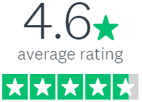
Sponsor Survey Results At-A-Glance
75%
100%
(-1% from 2023)
(Flat from 2023)
(4.3 Average Rating in 2023)
Said they had Sufficient Opportunities to Network/Connect with Attendees
Rated the Effectiveness of the Exhibit Hall as Extremely Effective/Very Effective
75%
76%
100%
(Flat from 2023)
(+1% from 2023)
(Flat from 2023)
Mentioned they were Extremely Satisfied/Satisfied with the Quality & Quantity of Leads Generated
Said they Got all the Right Information Leading up to Connections
Said the Mobile App was Very Effective/Somewhat Effective in helping Connect to Attendees and Expand Brand Exposure

Slide 28
Please rate your overall satisfaction with each of the following on a scale from 1 to 5 (with 1 being the lowest and 5 being the highest):
Area of Event | Weighted Average (1 – 5)
Women’s Luncheon | 5.0
On-Site Registration Process | 4.93
Helpfulness of iPipeline Staff | 4.88
Keynote Presentations | 4.87
General Session Content | 4.80
Pre-Event Registration Process | 4.80
Breakout Session Duration | 4.80
Opening Reception at SeaWorld | 4.79
Exhibitor Reception | 4.73
Company Exposure/Branding | 4.69
Networking Time During Conference | 4.65
Lunch in the Exhibit Hall | 4.65
Pre-Event Communications | 4.60
Breakfast in the Exhibit Hall | 4.56
Connections Event Website | 4.53
Breakout Session Content | 4.50
2023 Scores
N/A
4.89 (+.04 / +.82%)
4.69 (+.19 / +4.05%)
4.56 (+.31 / +6.8%)
4.0 (+.80 / +20%)
4.63 (+.17 / +3.67%)
4.56 (+.24 / +5.26%)
4.40 (+.39 / +8.86%)
4.44 (+.29 / +6.53%)
4.44 (+.25 / +5.63%)
4.38 (+.27 / +6.16%)
4.63 (+.02 / +.43%)
4.67 (-.07 / -1.5%)
4.60 (-.04 / -.87%)
4.57 (-.04 / -.88%)
4.47 (+.03 / +.67%)
2023 Spread:
High: 4.89 Low: 4.00

Slide 29
Sponsor/Partner Open-Ended Responses

Slide 30
What Did You Like Most About Connections?

Slide 31
Notes:
My first Connections and I really hope not my last. A very professional and extremely well run event. Your staff is to be commended! Thank you for everything!!
The collegial nature of the attendees and the iPipeline staff. Everyone I met from iPipeline was very professional and not only helpful, but were over the top in terms of their helpfulness, camaraderie and enthusiasm for the event and the community. Well done!
I liked the layout of the hall, helped drive traffic to our booth
The iPipeline staff during the conference and the venue. I also enjoyed the flow of the events.
Reconnecting with industry partners and creating new relationships.

Slide 32
Is There Anything Else You’d Like to Share About Your Experience at Connections?

Slide 33
Notes:
the iPipe staff is very attentive to the attendees and helps them to make connections
Great job! Good information in the sessions and well organized.
More outreach pre-show with sponsor attendees to hear about goals for the show and how we can work together to gain exposure and value within the whole show agenda - not just booths
Specific opportunities for more (all levels) of sponsors to be included in the user sessions or to have a spotlight moment during the receptions, etc.

Slide 34
Fun Tidbits

Slide 35
Connections 2024 Fun Tidbits
13 New BGA Buzz Subscriptions Received
Two Customers Already “Self Nominated” for 2025 Awards (DBS & OneAmerica)
Surpassed 17,000 LinkedIn Followers while Onsite (5.16)
6 Video Customer Testimonials Acquired
11 Additional Breakout Sessions Offered (46 vs 35)
15 Additional Industry Presenters/Companies
29,500+ LinkedIn Post Impressions Week of Event

Slide 36
Salesforce Opportunities
26 Opportunities Totaling +$4.3M
4 Demonstrations - $588,247.50
7 Prequalified - $1,511,477.50
7 Proposal – $590,617.62
8 Qualified – $1,632,736.79
9X ROI (Currently) &
+430% from 2023
Notes:
9x return on investment
430% increase from 2023 in opportunity revenue – last year we had11 Opportunities totaling +$812K
We should see total opps continue to grow – it’s even up 4% since last Thursday and demos are up 13% since last Thursday s
like 1
[10:42 AM] Jared Bruley
Demos are up 13% from Thursday

Slide 37
Connections 2025 & Beyond
Jared Bruley

Slide 38
Connections 2025 & Beyond
2025 Detailed Execution Plan Built by End of June
(Already In Progress)
2025 Creative/Look Finalized by Mid-July (Already In Progress)
2026 & 2027 Venue Recommendations Shared by End of July
2025 “Call for Speakers” & Steering Committee Launch Mid-August

Slide 39
Closing Thoughts
Jared Bruley & Christin DeLuzio

Slide 40
Closing Thoughts
Overall, Connections 2024 was executed and implemented well – very positive feedback from attendees, sponsors, and iPipeline staff
Continue to leverage, optimize, and improve best practices implemented for 2024 into 2025 (Early-Bird Pricing, Steering Committee, Session Reviews, Executive Committee)
Areas of opportunity for the business to continue to strengthen breakout session content and ensure proper balance of delivering content to match attendee expectations
Further evaluate and build-out deeper Wealth Management track/offerings
Launch “Call for Speakers” for deeper industry representation on content/topics
Event team will leverage feedback from survey and build and optimize event into 2025
Notes:
Push our messaging to the rest of iPipeline employees – send something in the HR Comm

